Slide 1
THE AI CLUB by Shailendra kadre
Feature Selection
Filter Method
Wrapper Method
Embedded Method
Pipelining
By :- Himanshu Sharma

Slide 2

Need of Feature Selection: reducing complexity of model and removing redundancy in model.
Method Discussed
1) Filter Method
2) Wrapper Method
3) Embedded Method
Source: Pixabay

Slide 3
Filter Method
Statistical tool based making it computationally cheap.
Correlation Coefficient
Variance Threshold
Information Gain
Chi-Square Test
Fisher’s Score
Source: Pixabay

Slide 4
Correlation Coefficient
Limitations
Linear correlation is not able to detect higher order correlation between attributes.
In real world scenario given features naturally have correlation between composite attributes and linear correlation fails to look for it.
It is the measure of relationship between two features.
The core idea is that a particular feature should be correlated to target attribute and features should have less correlation among themselves.
Those features are dropped which are having high correlation to other features.
Source: Pixabay

Slide 5
VARIANCE THRESHOLD
It is used to remove those attributes which are constant or near to constant by a threshold.
This works on assumption of
“adequate variance
=
more information”
This method is good to use only at the first stage of feature selection.
Source: Pixabay

Slide 6
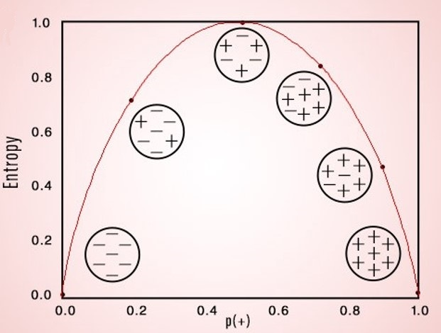

Information Gain = E(parent) – Avg(E(child))
INFORMATION GAIN
Entropy= $−\sum_{i=1}^{n}{P_{i}\log_{2}\left(Pi\right)}$
Gini Index = $1−\sum_{i=1}^{n}{{\left(p_{i}\right)}^{2}}$
Determine usefulness of attribute in discrimination.
Information Gain is derived from the entropy of the attribute or the Gini index.
Here we select those features which have high information gain in context of target.
Source: Pixabay

Slide 7
Limitations
This works for categorical feature set which are sampled independently.
For each feature to each target’s class frequency or expected frequency should be higher than 5. Other wise the chi-square test will not be good process to test null hypothesis of dependency.
If this anomaly happens then we should use fisher test for feature selection.
CHI – SQUARE
In feature selection we find chi-square value of every feature in feature set to target feature for dependency.
Features with best chi-square score are selected from the primary feature set.

Slide 8
FISHER’S SCORE
In the given feature set, every feature has a associated fisher score.
Then model is made out of those feature which have higher fisher score.
This method is available in skfeature library in python.
https://jaketae.github.io/study/fisher/
Source: Pixabay

Slide 9
WRAPPER METHOD
Forward Feature Selection
Backward Feature Elimination
Exhaustive Feature Selection
Recursive Feature Elimination

Slide 10
FORWARD FEATURE SELECTION
In feature selection method the model start with zero features.
One by one, that feature is selected which makes highest improvement in model prediction.
This selection stop adding features to model when halting condition arrives.

Slide 11
BACKWARD FEATURE ELIMINATION
In this method first we build model with selecting all features.
Then we remove that feature from model which result in greatest prediction improvement.
This procedure is followed till a limiting condition is achieved like number of features used or when accuracy start dropping.
Source: Pixabay

Slide 12
EXHAUSTIVE FEATURE SELECTION
As the name suggest it is a brute force method.
This method guarantee for the best models from the supplied features with least number of features used.
Computationally heavy, hence not much used in business environment.
Source: Pixabay

Slide 13
RECURSIVE FEATURE ELIMINATION
A very similar feature elimination method to Backward feature elimination.
But the difference is that, backward feature elimination remove attributes if its removal improve model performance and this method remove feature which are least important in model by using feature_importance_ranking or regression coefficient.
Source: Pixabay

Slide 14
EMBEDDED METHOD
LASSO (L1) Regularization
Random Forest Importance
Source: Pixabay

Slide 15
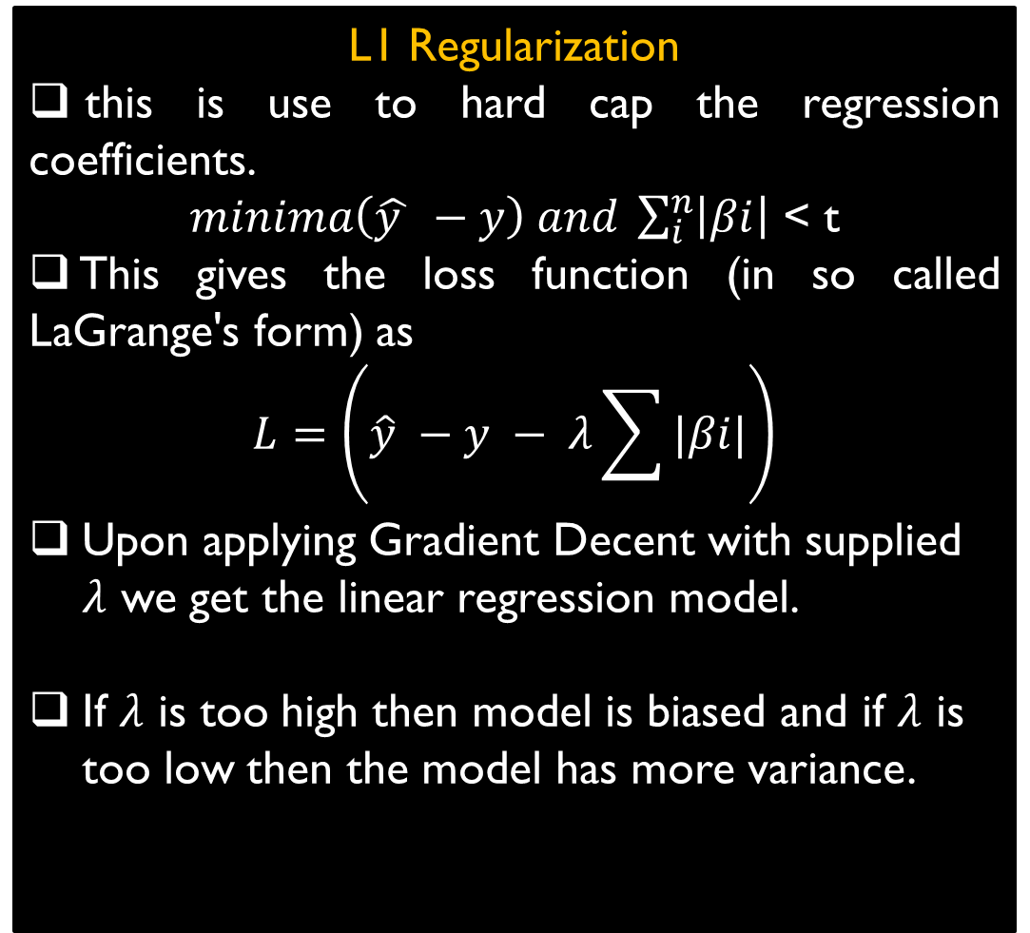
LASSO REGULARIZATION
L1 Regularization
this is use to hard cap the regression coefficients.
$minima\left(\hat{y } −y\right) and \sum_{i}^{n}{\left|βi\right|}$ < t
This gives the loss function (in so called LaGrange's form) as
$$L=\left(\hat{y} −y − λ\sum{|βi|}\right)$$
Upon applying Gradient Decent with supplied $λ$ we get the linear regression model.
If $λ$ is too high then model is biased and if $λ$ is too low then the model has more variance.
Used to improve prediction of model and maintain feature interpretability.
LASSO is least absolute shrinkage and selection operator also known as L1 regularization.
It shrinks the regression coefficients to make use of less features in model.
The penalty term is calculated from the regression coefficients.
This can we use also in logistic regression as there we use sigmoid function.
Source: Pixabay

Slide 16
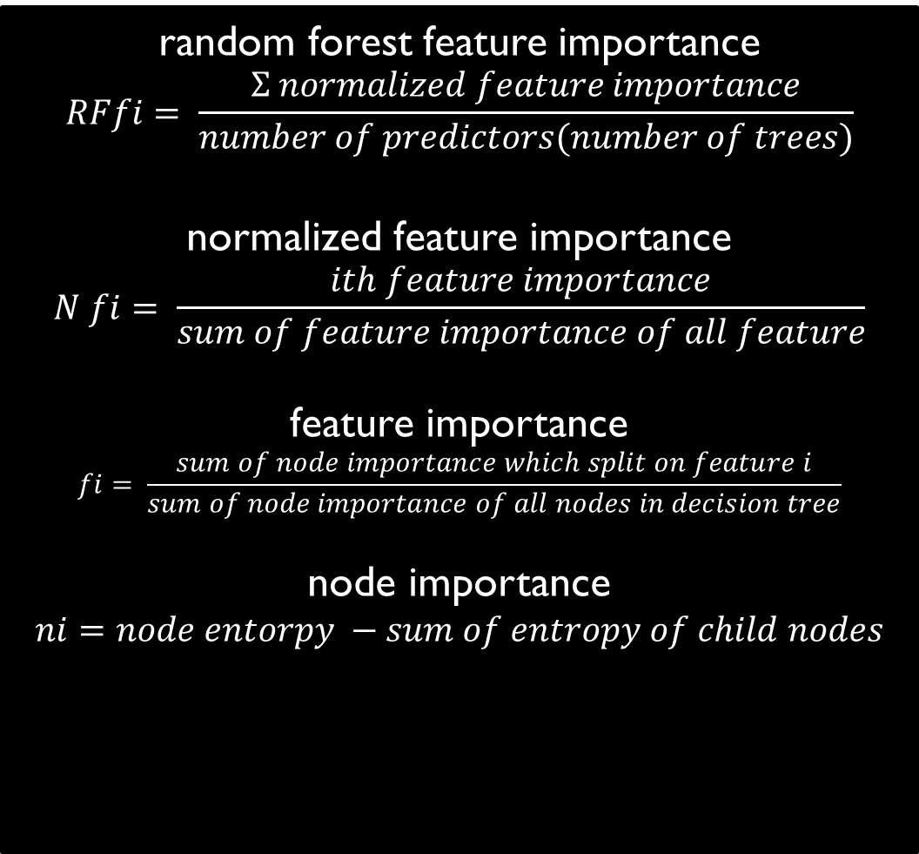
random forest feature importance
$$RFfi= \frac{Σ normalized feature importance}{number of predictors(number of trees)}$$
normalized feature importance
$$N fi= \frac{ith feature importance}{sum of feature importance of all feature}$$
feature importance
$$fi= \frac{sum of node importance which split on feature i}{sum of node importance of all nodes in decision tree}$$
node importance
$$ni=node entorpy −sum of entropy of child nodes$$
RANDOM FOREST IMPORTANCE
Random Forest feature importance is a factor calculated from the feature’s importance in nth-decision tree which itself is calculated from the node importance in ith decision tree.
Features are then ranked w.r.t. the importance factor and then used to make model with least number of features.
This is highly accurate method of feature selection.
https://towardsdatascience.com/box-cox-transformation-explained-51d745e34203
Source: Pixabay

Slide 17
The Segmentation of overall process of model making, which help in automation of the process of model making.
This Segmentation is done to makes units performing data formatting to desired dataset representation (like pandas data frame), data cleaning , adding or removing columns , feature selection/engineering , model accuracy tuning.
The output of segment is piped to input of other segment and this way we make the whole workflow.
This makes model capable of continuous prediction (capable of adapting to new data after model is made).
Model development can be easily spread across the development team.
MACHINE LEARNING
PIPELINING
Source: Pixabay

Slide 18



































THANK YOU
Q & A
This was a short presentation on different
Feature Selection Methods
AND
Pipelining

